Slide 1
Unit 1 Vocabulary Honors World Geography

Slide 2
Unit 1
Rub al-Khali
Oasis
Bedouin
Nomad
Desalinization
Organization of Petroleum Exporting Countries
Quran
Civilization
Desert
Dome of the Rock
Wadi
Shari’ah
Sunni
Delta
City-state
Polytheism/Monotheism
Theocracy
Pastoralism
Megalopolis
Shi’ite
Aquifer
Kurds
Guest worker
Renewable Resource
Torah
Covenant
Palestinians
Buffer zone
Suez Canal
Demographics

Slide 3
Wadi
A riverbed that remains dry except during the rainy seasons.

Slide 4
Covenant
A solemn pledge or agreement (like a contract)

Slide 5
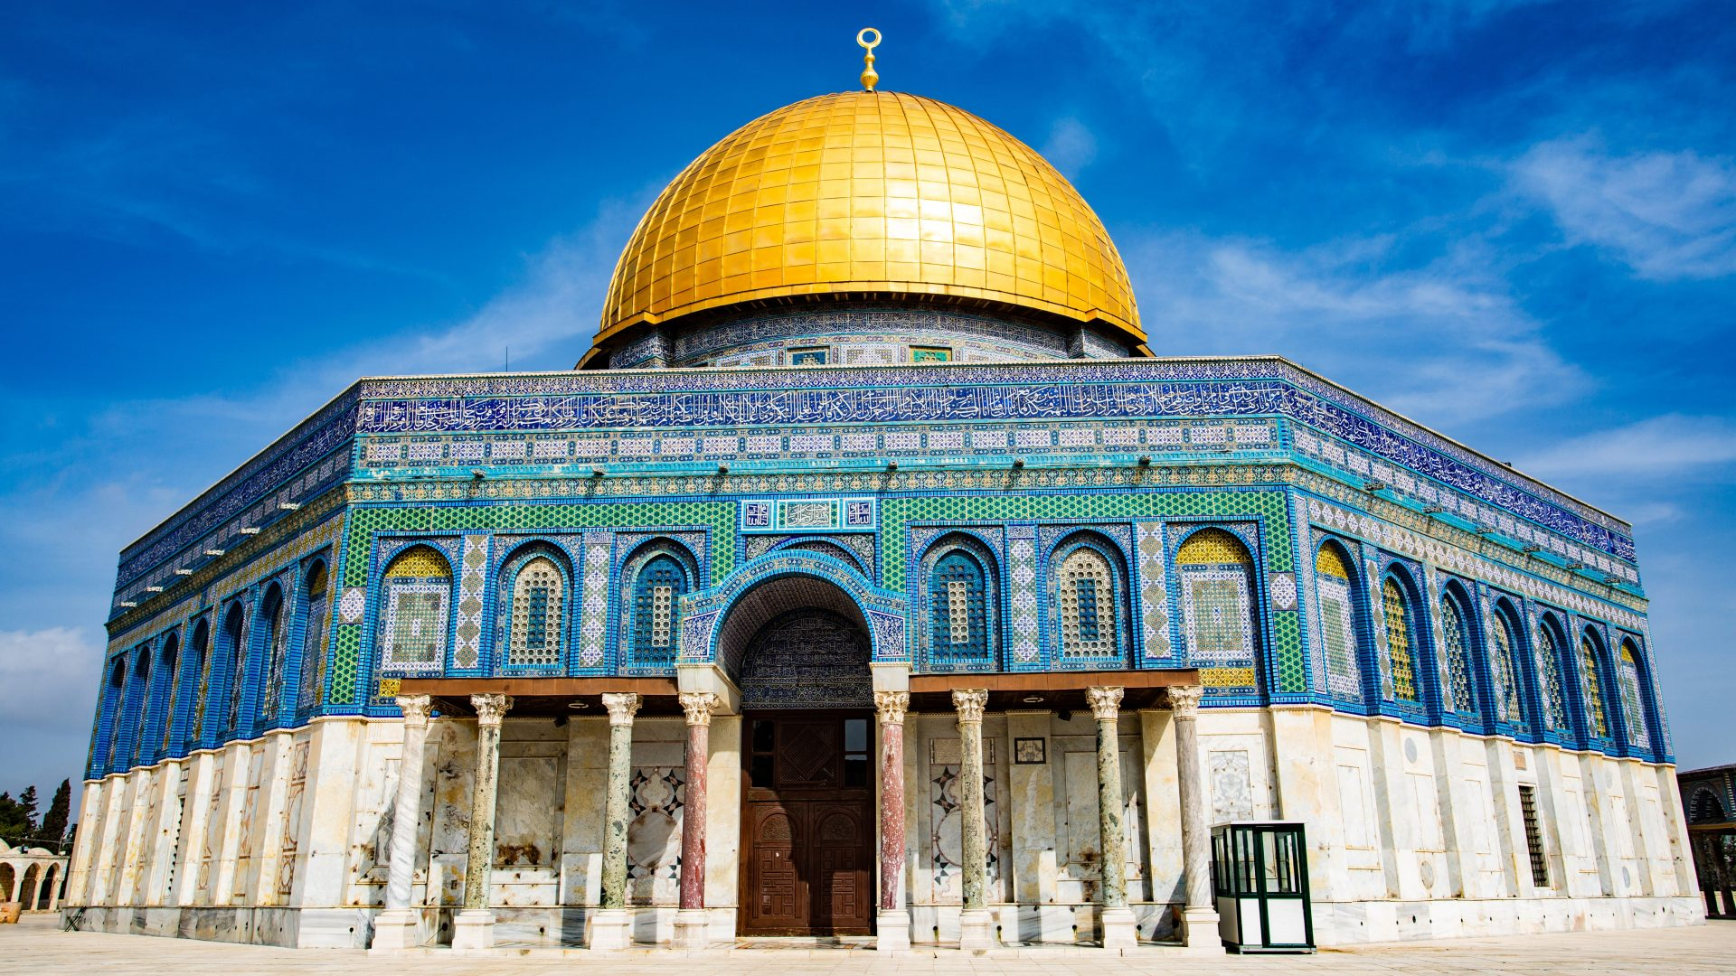
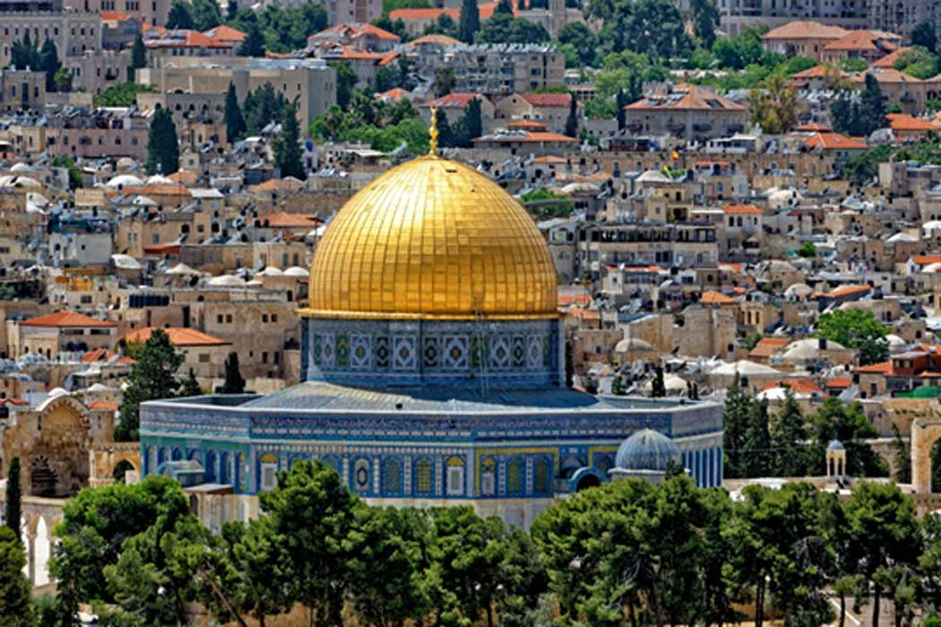
Dome of the Rock
A shrine in Jerusalem, located on the Temple Mount, which houses the spot where Muslims believe Muhammad rose into heaven and where Jews believe Abraham prepared to sacrifice his son Isaac to God.

Slide 6
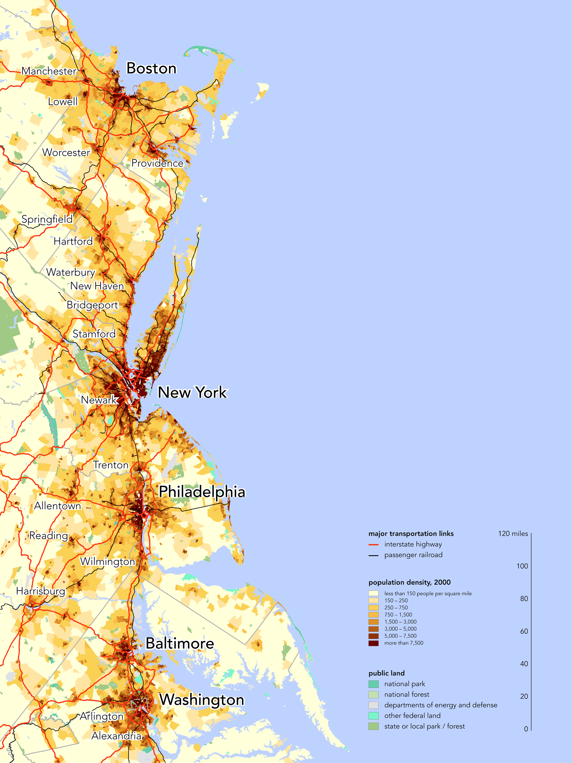
Megalopolis
A region in which several large cities and surrounding areas grow together.

Slide 7
Bedouin
Member of the nomadic desert peoples of North Africa and Southwest Asia

Slide 8
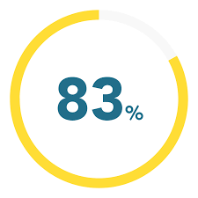
Sunni
One of two main branches of Islam, comprising about 83 percent of all Muslims.

Slide 9
Shi’ite
One of the two main branches of Islam including most Iranians and some populations of Iraq and Afghanistan.

Slide 10
Nomad
A member of a group that has no permanent home, wandering from place to place in search of food and water

Slide 11
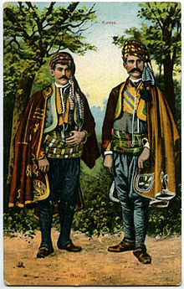
Kurds
An ethnic group in SW Asia that has occupied Kurdistan, and parts of Turkey, Iraq, and Iran for about a thousand years.

Slide 12
Renewable Resource
A resource that can be used repeatedly and does not run out because it is naturally replaced

Slide 13
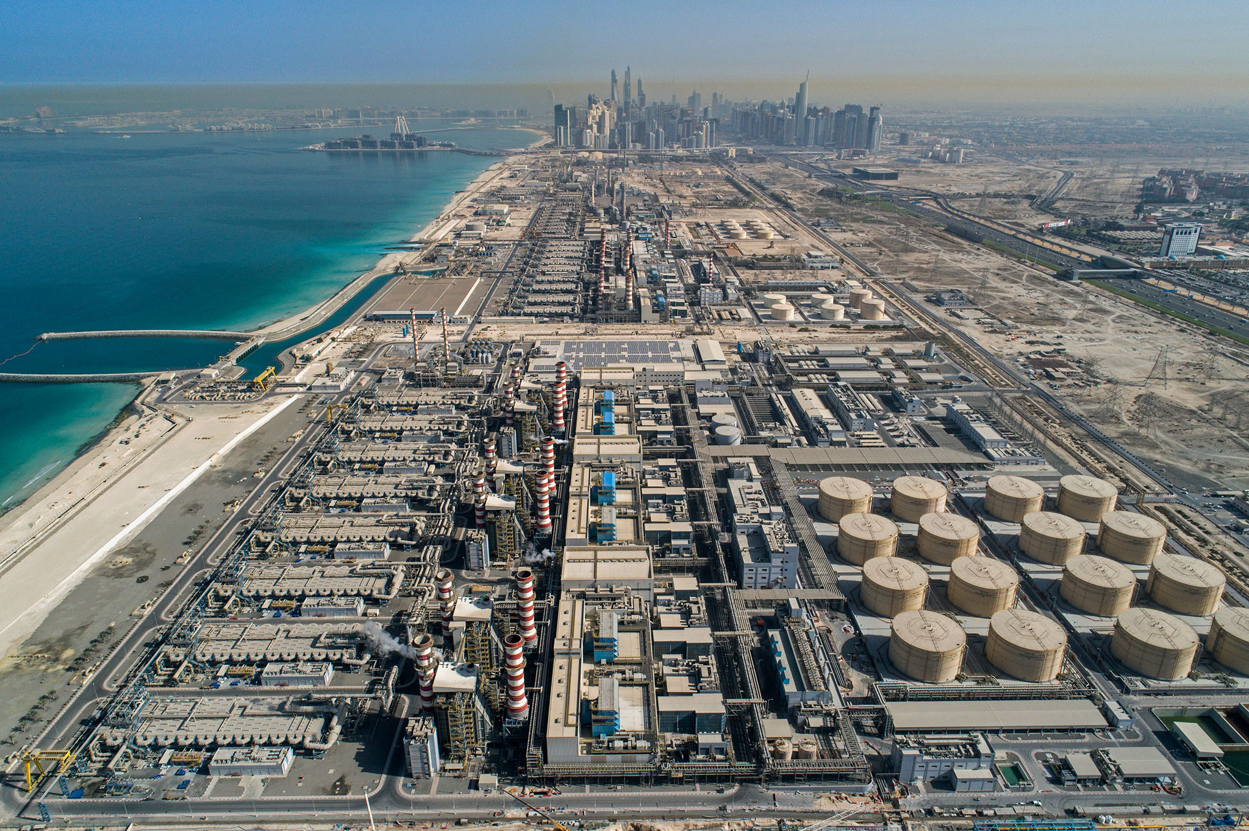
Desalinization
The removal of salt from ocean water.

Slide 14
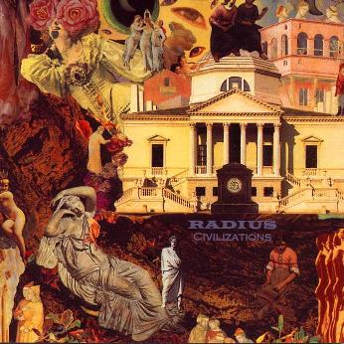
Civilization
Highly organized society marked by advanced knowledge of trade, government, arts, science, and often written language

Slide 15
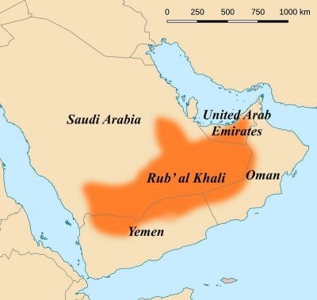
Rub al-Khali
The largest sandy desert in the world located on the Arabian Peninsula; also known as the Empty Quarter.

Slide 16
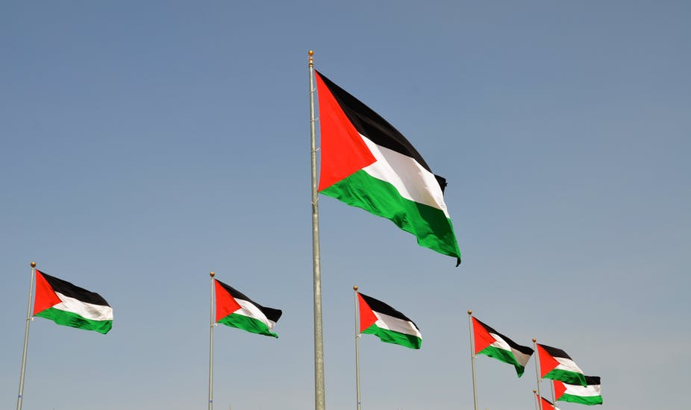
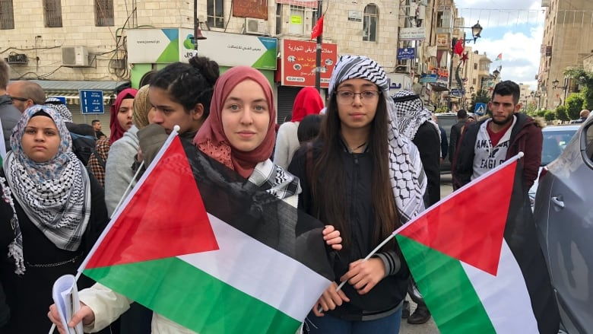
Palestinians
A group of Arabs who lived or still live in the area formerly called the Palestine Mandate (modern-day Israel).

Slide 17
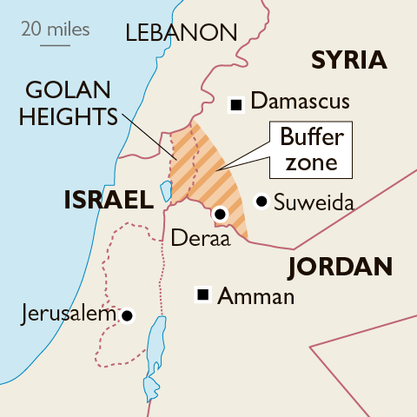
Buffer zone
A neutral area separating conflicting forces.

Slide 18
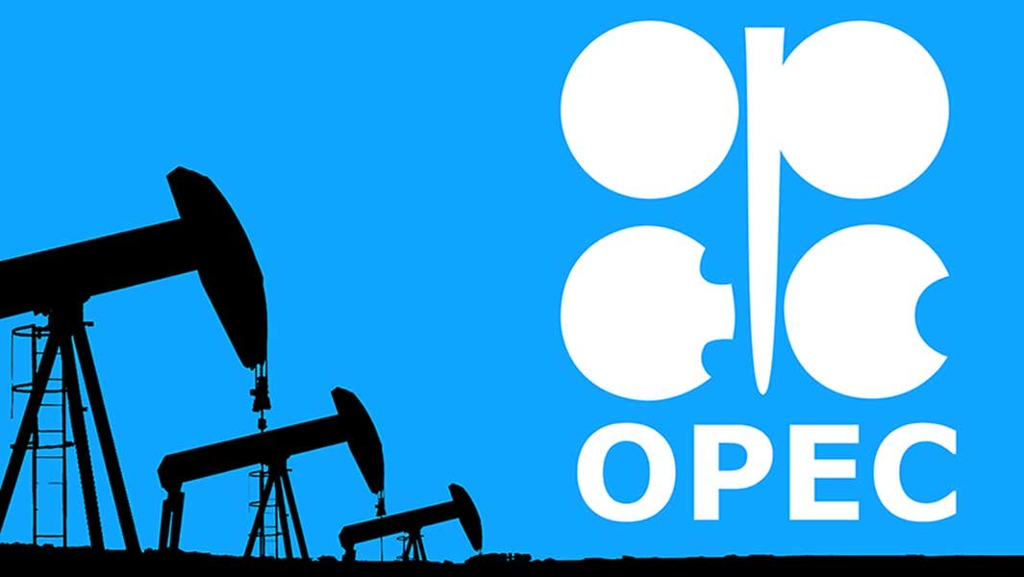
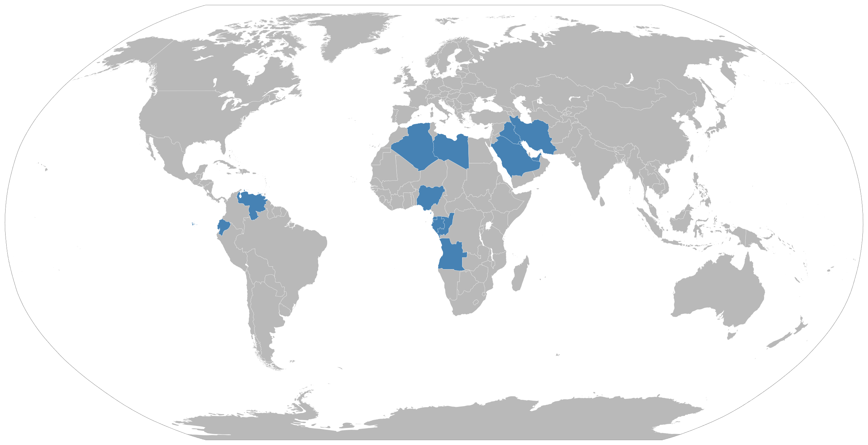
Organization of Petroleum Exporting Countries
(OPEC) A group established in 1960 by some oil-producing nations to coordinate policies on selling petroleum products.

Slide 19
Delta
Fan-like landform made of deposited sediment, left by a river that slows as it enters the ocean.

Slide 20
City-state
An independent state consisting of a city and the surrounding land and villages

Slide 21
Polytheism/Monotheism
Worship of many gods (Polytheism)
Belief in a single god (Monotheism)

Slide 22
Theocracy
Government headed by religious leaders or a leader regarded as a god

Slide 23
Torah
The first five books of the Hebrew Bible – the most sacred writings in the Jewish tradition

Slide 24
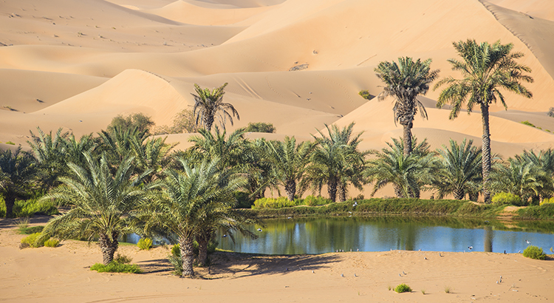
Oasis
A place where water from an aquifer (an underground source of water) has reached the surface; it supports vegetation and wildlife.

Slide 25
Desert
Area of land having a very warm climate and receiving less than 10 inches of sporadic rainfall annually.

Slide 26
Guest worker
A largely unskilled laborer, often an immigrant from South and East Asia, brought in to the oil-booming countries to fill job openings that the region’s native peoples find culturally or economically unacceptable.

Slide 27
Quran
The holy book of Islam.

Slide 28
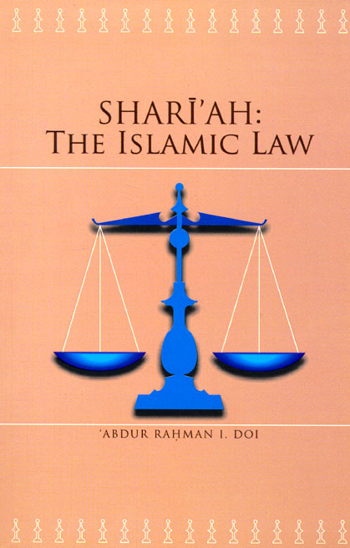
Shari’ah
Islamic code of law that includes rules for all aspects of life.

Slide 29
Suez Canal
Man-made canal connecting the Mediterranean Sea to the Indian Ocean via the Red Sea.

Slide 30
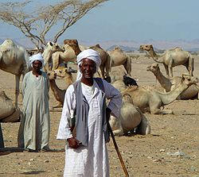
Pastoralism
The practice of herding as the primary economic activity of a society that emerged in parts of Africa and Eurasia.

Slide 31
Aquifer
An underground layer of rock that stores water.

Slide 32
Demographics
The statistical study of human populations and characteristics that can include information on population size, density, growth, and organizational groupings such as race, gender, or age.

